Slide 1
数据库专题训练
数据库新型检索技术
近似抽取
计算机系软件所数据库组 李国良
DB Training - Approximate Entity Extraction

Slide 2
Outline
Motivation
Problem Formalization
Straightforward Methods
Multi-Heap Based Method
Single-Heap Based Method
Pruning Techniques
DB Training - Approximate Entity Extraction

Slide 3
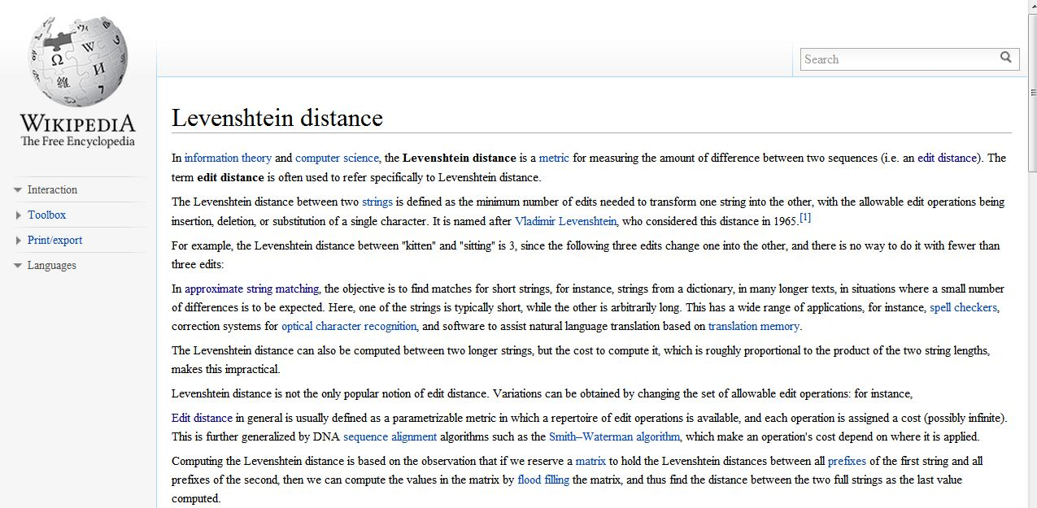
Named Entity Recognition
Wikipedia
http://en.wikipedia.org/wiki/Levenshtein_distance
DB Training - Approximate Entity Extraction

Slide 4
Named Entity Recognition
Dictionary-based NER
Documents
1 Sir IsaacNewton was an English physicist, mathematician, astronomer, natural philosopher, alchemist, and theologian and one of the most influential men in human history. His Philosophiæ Naturalis Principia Mathematica, published in 1687, is by itself considered to be among the most influential books in the history of science, laying the groundwork for most of classical mechanics.
2 Sigmund Freund was an Austrian psychiatrest who founded the psychoanalytic school of psychology. Freud is best known for his theories of the unconscious mind and the defense mechanism of repression and for creating the clinical practice of psychoanalysis for curing psychopathology through dialogue between a patient and a psychoanalayst.
Dictionary of Entities
Isaac Newton Sigmund Freud English Austrian physicist mathematician astronomer philosopher alchemist theologian psychiatrist economist historian sociologist ...
DB Training - Approximate Entity Extraction
Notes:
You don’t need to write it down, but try to mention some of the applications of NER (e.g., for data mining on the web / medline abstract, etc.)
I guess you want to illustrate the process of ‘dictionary-based NER’ (beware that there are other types of NER, e.g., based on machine learning)
However, you probably can use a dictionary with more tokens, to illustrate the fact that naïve algorithm needs to try all l_min to l_max length windows at each position of the text.

Slide 5
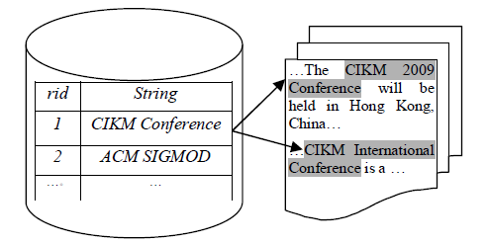
Approximate Entity Extraction
Conference Extraction
DB Training - Approximate Entity Extraction

Slide 6
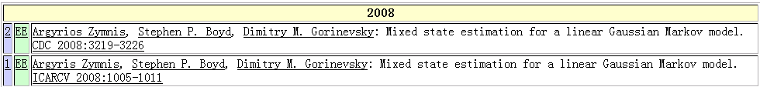
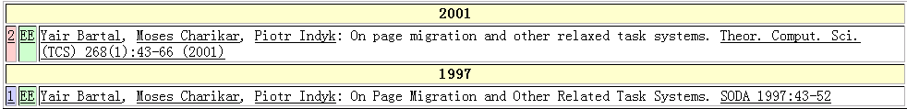
Real-world Data is Rather Dirty！☹
DBLP Complete Search
Typo in “author”
Typo in “title”
Argyrios Zymnis
Argyris Zymnis
relaxed
related
DB Training - Approximate Entity Extraction

Slide 7
Outline
Motivation
Problem Formalization
Straightforward Methods
Multi-Heap Based Method
Single-Heap Based Method
Pruning Techniques
DB Training - Approximate Entity Extraction

Slide 8
Problem Formulation
Input
  a dictionary R
  a document D
Output
  all substrings s from D which are similar to an entity e in R.
    all <e, s>, s.t. e in R, s is a substring of D, and e and s are similar
    Edit distance or jaccard similarity
DB Training - Approximate Entity Extraction

Slide 9
Outline
Motivation
Problem Formalization
Straightforward Methods
Multi-Heap Based Method
Single-Heap Based Method
Pruning Techniques
DB Training - Approximate Entity Extraction

Slide 10
Solutions
First enumerate all substrings of D
Then use the following methods
  Approximate String Search based methods
    For each substring, using approximate string search based methods to find similar entities in set R
  Similarity join based methods
    Suppose S is the set of all substrings in D, using similarity join based methods on string set S and entity set R
DB Training - Approximate Entity Extraction

Slide 11
Problems
Too many substrings
Can we prune some substrings?
DB Training - Approximate Entity Extraction

Slide 12
Length Pruning for Edit Distance
Suppose Rmin and Rmax is the minimum and maximum entity length
Valid Substrings: length between Rmin-τ and Rmax+τ
For edit-distance threshold τ, we can prune,
  All substrings with length smaller than Rmin-τ
  All substrings with length larger than Rmax+τ
Example
  given τ =1
  entities rich stick stich stuck sttic
  Rmin = 4, Rmax = 5
  Valid substrings with length between 3 and 6, and prune others
DB Training - Approximate Entity Extraction

Slide 13
Length Pruning for Jaccard Similarity
Suppose Rmin and Rmax is the minimum and maximum number of tokens in entities
Valid Substrings: length between Rmin* δ and Rmax/ δ
For jaccard-similarity threshold δ, we can prune,
  All substrings with number of tokens smaller than Rmin* δ
  All substrings with length larger than Rmax/ δ
Example
  given δ = 0.8
  entities “icde vldb sigmod” “db ir dm ml”
  Rmin = 3, Rmax = 4
  Valid substrings with length between 3 and 5, and prune others
DB Training - Approximate Entity Extraction

Slide 14
Outline
Motivation
Problem Formalization
Straightforward Methods
Multi-Heap Based Method
Single-Heap Based Method
Pruning Techniques
DB Training - Approximate Entity Extraction

Slide 15
Multiple-heap-based Methods
Step 1: Construct q-gram inverted lists for set R.
Step 2: For each valid substring of D, construct a heap.
Step 3: Adjust the heap, count # of occurrences of each entity.
Step 4: Verify the candidate pairs.
DB Training - Approximate Entity Extraction

Slide 16
Multiple-heap-based Methods
For each valid substring (that satisfies the length filter), construct a heap to count and filter substrings based on count filtering:
DB Training - Approximate Entity Extraction

Slide 17
Multi-Heap based Example
Step 1: Construct 2-gram inverted lists for set R.
ch
ck
ic
ri
st
tt
ti
tu
uc
0
2
id strings
0
1
2
3
4
rich
stick
stich
stuck
sttic
1
3
2-grams
0
1
2
4
0
1
2
3
4
4
1
2
4
3
3
2-gram inverted list for set R
DB Training - Approximate Entity Extraction

Slide 18

Multi-Heap based Example
Step 2: For every valid substring of D, construct a heap.
Document:
srich and sthick
Valid Substring:
sri ric ich ch_ h_a _an and nd_ d_s _st sth thi hic ick
sric rich ich_ ch_a h_an _and and_ nd_s d_st _sth sthi thic hick
srich rich_ ich_a ch_an h_and _and_ and_s
nd_st
d_sth _sthi sthic thick
srich_ rich_a ich_an ch_and h_and_ _and_s and_st
nd_sth
d_sthi _sthic sthick
Valid substrings:
st th hi ic ck
1
2
3
4
0
1
2
4
1
3
Count # of occurrences
sthick
DB Training - Approximate Entity Extraction

Slide 19

Muti-Heap based Method
Step 3. Adjust the heap, count # of occurrences of each entity. E.g., |sthick|=6
# of occurrence >=
= 6 – 2 + 1 – 1 * 2 = 3
0
1
minHeap
1
0
1
1
1
1
3
0
1
2
2
3
2
1
2
3
4
0
1
2
4
1
3
4
2
1
(stick, sthick) is a candidate
DB Training - Approximate Entity Extraction

Slide 20
Muti-Heap based Method
Step 4: Verify the candidate pairs.
ED(stick, sthick) = 1 <= τ, add it as an answer
DB Training - Approximate Entity Extraction

Slide 21
Problems
Many substrings share common grams
CANNOT use the shared grams and involve unnecessary computation
DB Training - Approximate Entity Extraction

Slide 22
Outline
Motivation
Problem Formalization
Straightforward Methods
Multi-Heap Based Method
Single-Heap Based Method
Pruning Techniques
DB Training - Approximate Entity Extraction

Slide 23
Motivation
Repeated computation as many substrings share common grams
How to use the shared grams and avoid unnecessary computation
DB Training - Approximate Entity Extraction

Slide 24
Single Heap based Method
Step 1: Build q-gram inverted lists for set R.
Step 2: Construct a single heap for entire document.
Step 3: Adjust the heap, use a set of arrays to count occurrences # of each entity in each valid substring.
Step 4: Verify the candidate pairs.
DB Training - Approximate Entity Extraction

Slide 25
Single Heap based Example
Example: q = 2, τ= 1.
Length filter: min_len = 4 – 1 = 3 and max_len = 5 + 1 = 6
Dictionary R
Document D
ID | Entity | Length
0 | rich | 4
1 | stick | 5
2 | stich | 5
3 | stuck | 5
4 | sttic | 5
srich and sthick
DB Training - Approximate Entity Extraction

Slide 26
Single Heap based Example
Step 1: Construct 2-gram inverted lists for set R.
ch
ck
ic
ri
st
tt
ti
tu
uc
0
2
id strings
0
1
2
3
4
rich
stick
stich
stuck
sttic
1
3
2-grams
0
1
2
4
0
1
2
3
4
4
1
2
4
3
3
2-gram inverted list for set R
DB Training - Approximate Entity Extraction

Slide 27
Single Heap based Method
Step 2: Construct a single heap for the entire document
srich and sthick
sr ri ic ch h_ _a an nd d_ _s st th hi ic ck
0
0
1
2
4
0
2
1
2
3
4
0
1
2
4
1
3
heap for the entire document
DB Training - Approximate Entity Extraction

Slide 28
Single Heap based Method
Step 3: Adjust the heap, use a set of arrays to count occurrences # of each element in each valid substring.
Arrays to count the occurrence of element 1 “stick”
Current element “stick” has length filter min_len=5-1=4, max_len=5+1=6
Add (stick,sthick) (stick,sthic) (stick,thick) (stick,hick) to candidate
# of occurrence
6
5
4
1 1 1 0 0 0 1 1 1 2 3
3
2
2
1 1 1 0 0 0 0 1 1 1 2 2
1 1 1 0 0 0 0 0 1 1 1 1 2
Length
Min occur time
sr ri ic ch h_ _a an nd d_ _s st th hi ic ck
1 1 1 1
DB Training - Approximate Entity Extraction

Slide 29
Muti-Heap based Method
Step 4: Verify the candidate pairs.
ED(stick, sthick) = 1
ED(stick, sthic) = 2
ED(stick, thick) = 2
ED(stick, hick) = 2
DB Training - Approximate Entity Extraction

Slide 30
Outline
Motivation
Problem Formalization
Some Basic Techniques
Multi-Heap Based Method
Single-Heap Based Method
Pruning Techniques
DB Training - Approximate Entity Extraction

Slide 31
Pruning Techniques
Lazy-Update Pruning
Bucket Pruning
Length Pruning
Iterative-Update Pruning
DB Training - Approximate Entity Extraction

Slide 32
Lazy-Update Pruning
For each element, we don’t update its # of occurrence in each substring unless # of occurrence in entire heap is larger than
Lmin − τ − q + 1 − τ ∗ q
DB Training - Approximate Entity Extraction

Slide 33
Lazy-Update Pruning
Suppose Lmin = 6, τ = 1, q=2.
For example, if we have a heap as below.
1
Lmin- τ -q+1- τ *q=2
1
3
1 2 3
Then we can prune element 1,2,4,7,9 whose # of occurrence is less than 2
1
3
4
5
6
8
2
5
6
7
8
9
3
5
8
DB Training - Approximate Entity Extraction

Slide 34
Length Pruning
Edit distance
Given an entity in the heap, e, if its occurrence number is smaller than
  max(|e|, Lmin − τ) − q + 1 − τ ∗ q
We can prune e.
DB Training - Approximate Entity Extraction

Slide 35
Length Pruning
Jaccard Similarity
Given an entity in the heap, e, if its occurrence number is smaller than
  max(|e|, Lmin ) * δ
We can prune e.
DB Training - Approximate Entity Extraction

Slide 36

Bucket Pruning
We can divide the element occurrence into two buckets if their span is larger than τ *q.
For example:
Span = 9 > 2
Bucket 1
Bucket 2
sr ri ic ch h_ _a an nd d_ _s st th hi ic ck
1
2
3
4
0
1
2
4
1
3
0
0
1
2
4
02
0
0 0 0
DB Training - Approximate Entity Extraction

Slide 37

Iterative-Update Pruning
With the same start position, the longer the substring is, the larger the # of occurrence of each element is.
For example, for entity 2 (stich), we have
l−q+1−τ∗q = 2
These are less than 2, we can prune the shorter substings.
6
5
4
2 2 2 1 0 0 1 1 1 2 2
3
2
2
2 2 2 1 2 1
1 2 2 1 1
Length
Min occur time
sr ri ic ch h_ _a an nd d_ _s st th hi ic ck
2 2 2 2
DB Training - Approximate Entity Extraction

Slide 38
Approximate Entity Extraction
Step 1: Build q-gram inverted lists for set R.
Step 2: Construct a single heap for entire document.
Step 3: Adjust the heap, use a set of arrays to count occurrences # of each entity in each valid substring.
  Lazy-update
  Iterative-update
  Length
  Bucket
Step 4: Verify the candidate pairs.
DB Training - Approximate Entity Extraction

Slide 39
A Trie-based Method
DB Training - Approximate Entity Extraction

Slide 40
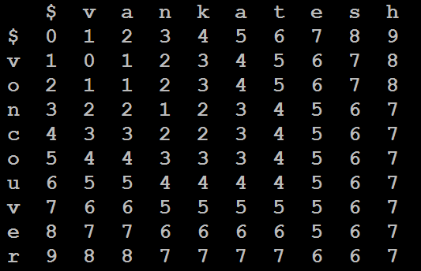
Observation
Set τ=2 entity:vankatesh
document: …voncouver…
Split the entity into τ+1=3 segments
A substring in document
DB Training - Approximate Entity Extraction

Slide 41
Observation
Set τ=2 entity:vankatesh
document: …voncouver…
>= 1
edit operation
>= 1
edit operation
>= 1
edit operation
If a string does not match any segment
>= τ + 1 = 3 edit operations
NOT SIMILAR
DB Training - Approximate Entity Extraction

Slide 42
Observation
Enumerate valid substrings:
  s is a valid substring if
L_{min}− τ <=|s|<= L_{max}+ τ
  L_{min}: the minimum entity length.
  L_{max}: the maximum entity length.
For each valid substring, it is a candidate
  if it has a substring that matches a segment
How to find the matching segments?
DB Training - Approximate Entity Extraction
Notes:
Lemma: Given an entity e with τ + 1 segments and a substring s, if s is similar to e within threshold τ , s must contain a substring which is exactly a segment of e.

Slide 43
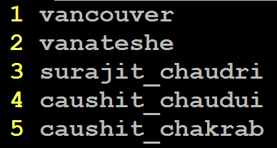
Trie-based Framework
Step1: Partition entities into segments using even partition scheme.
DB Training - Approximate Entity Extraction

Slide 44
Even Partition
Partition an entity into τ +1 disjoint segments, such that each segment has nearly the same length
Length:
  ⎡l/(τ+1)⎤ : last l%(τ+1) segments
  ⎣l/(τ+1)⎦ : other segments
L=8, τ=2:
  2 3 3
DB Training - Approximate Entity Extraction

Slide 45
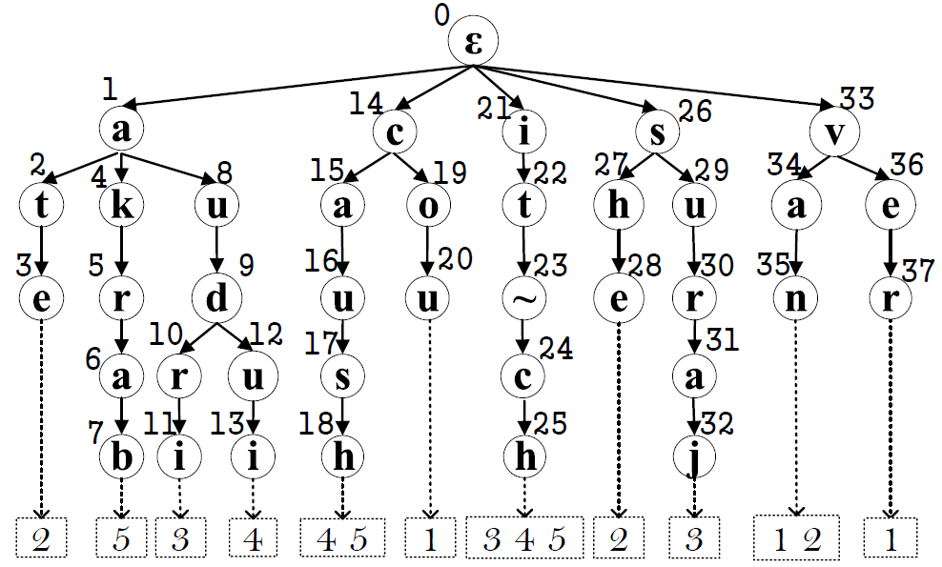
Trie-based Framework
Step2: Index the segments using a trie structure
DB Training - Approximate Entity Extraction

Slide 46
Trie-based Framework
Step3: From the document, find the matched segments from the trie structure.
Baseline: Trie-search Method
  3.1 Enumerator all valid substrings.
  3.2 Find each suffix of every substring in the trie structure to check if it can reach the leaf node.
  3.3 Verify the candidate pairs.
DB Training - Approximate Entity Extraction

Slide 47
Trie-search Method
3.1 Enumerate all valid substrings.
if L_{min} - τ = 9-2=7 L_{max} + τ = 15+2=17
kaushit chekrabarti, surajit chaudhuri, vankatesh ganti,
Len = 7
DB Training - Approximate Entity Extraction

Slide 48
Trie-search Method
3.1 Enumerator all valid substrings.
if L_{min} - τ = 9-2=7 L_{max} + τ = 15+2=17
kaushit chekrabarti, surajit chaudhuri, vankatesh ganti,
Len = 8
DB Training - Approximate Entity Extraction

Slide 49
Trie-search Method
3.1 Enumerator all valid substrings.
if L_{min} - τ = 9-2=7 L_{max} + τ = 15+2=17
kaushit chekrabarti, surajit chaudhuri, vankatesh ganti,
Len = 11
DB Training - Approximate Entity Extraction

Slide 50
Trie-search Method
3.1 Enumerator all valid substrings.
if L_{min} - τ = 9-2=7 L_{max} + τ = 15+2=17
kaushit chekrabarti, surajit chaudhuri, vankatesh ganti,
Len = 17
DB Training - Approximate Entity Extraction

Slide 51
Trie-search Method
3.2 Find each suffix of every substring in the trie structure to check if it can reach the leaf.
chaudhuri
Pruned
DB Training - Approximate Entity Extraction

Slide 52
Trie-search Method
3.2 Find each suffix of every substring in the trie structure to check if it can reach the leaf.
surajit chaud
Candidate
of entity 3
DB Training - Approximate Entity Extraction

Slide 53
Trie-search Method
3.3 Verify the candidate pairs
ED(surajit chaud, surajit chaudri)=2
DB Training - Approximate Entity Extraction

Slide 54
Trie-search Method
Shortage
  Large numbers of candidate pairs:
  <surajit_chaudhuri, surajit_chaudri>
  < urajit_chaudhuri, surajit_chaudri>
  <surajit_chaudhur , surajit_chaudri>
  …...
Duplicate Computations
DB Training - Approximate Entity Extraction

Slide 55
Trie-based Algorithm
Step3: From the document, find the matched segments from the trie structure.
To avoid duplicate computation, we do not enumerate all valid substrings.
Trie-based Method
  3.1 Search: Search matched segments.
  3.2 Extension: Extend the matched segments to find similar pairs.
DB Training - Approximate Entity Extraction
Notes:
To avoid the duplicated computations on the shared segment
across different substrings

Slide 56
Trie-based Algorithm
3.1 Search: Search matched segments.
kaushit chekrabarti, surajit chaudhuri, vankatesh ganti,
DB Training - Approximate Entity Extraction
Notes:
To avoid the duplicated computations on the shared segment
across different substrings

Slide 57
Trie-based Algorithm
3.2 Extend the matched segments to find similar pairs.
D: kaushit chekrabarti, surajit chaudhuri, vankatesh ganti,
e₃: surajit chaudri
e₄: caushit chaudui
e₅: caushit chakrab
DB Training - Approximate Entity Extraction
Notes:
To avoid the duplicated computations on the shared segment
across different substrings

Slide 58
 | k | a | u | s | h | i | t | _ | c | h | e | k | r | a | b | a | r
s | 5 | 4 | 4 | 4 | 5 | 5
u | 5 | 4 | 3 | 4 | 4 | 4
r | 4 | 4 | 3 | 3 | 3 | 3
a | 4 | 3 | 3 | 2 | 2 | 2
j | 5 | 4 | 3 | 2 | 1 | 1
i | 5 | 4 | 3 | 2 | 1 | 0
t
_
c
h
a
u
d
r
i
All Bigger
Than Two,
Terminate!
e₃
No Need to Compute This Range
DB Training - Approximate Entity Extraction
Notes:
To avoid the duplicated computations on the shared segment
across different substrings

Slide 59
 | k | a | u | s | h | i | t | _ | c | h | e | k | r | a | b | a | r
c | 1 | 1 | 2 | 3 | 4 | 5
a | 1 | 0 | 1 | 2 | 3 | 4
u | 2 | 1 | 0 | 1 | 2 | 3
s | 3 | 2 | 1 | 0 | 1 | 2
h | 4 | 3 | 2 | 1 | 0 | 1
i | 5 | 4 | 3 | 2 | 1 | 0
t
_
c
h |  |  |  |  |  |  |  |  |  | 0 | 1 | 2 | 3 | 4 | 5 | 6 | 7
a |  |  |  |  |  |  |  |  |  | 1 | 1 | 2 | 3 | 3 | 4 | 5 | 6
u |  |  |  |  |  |  |  |  |  | 2 | 2 | 2 | 3 | 4 | 4 | 5 | 6
d |  |  |  |  |  |  |  |  |  | 3 | 3 | 3 | 3 | 4 | 5 | 5 | 6
u |  |  |  |  |  |  |  |  |  | 4 | 4 | 4 | 4 | 4 | 5 | 6 | 6
i |  |  |  |  |  |  |  |  |  | 5 | 5 | 5 | 5 | 5 | 5 | 6 | 7
Not Bigger
Than Two,
Extend The
Right Part!
e₄
No Need to Compute This Range
All Bigger
Than Two,
Prune!
DB Training - Approximate Entity Extraction
Notes:
To avoid the duplicated computations on the shared segment
across different substrings

Slide 60
 | k | a | u | s | h | I | t | _ | c | h | e | k | r | a | b | a | r
c | 1 | 1 | 2 | 3 | 4 | 5
a | 1 | 0 | 1 | 2 | 3 | 4
u | 2 | 1 | 0 | 1 | 2 | 3
s | 3 | 2 | 1 | 0 | 1 | 2
h | 4 | 3 | 2 | 1 | 0 | 1
i | 5 | 4 | 3 | 2 | 1 | 0
t
_
c
h |  |  |  |  |  |  |  |  |  | 0 | 1 | 2 | 3 | 4 | 5 | 6 | 7
a |  |  |  |  |  |  |  |  |  | 1 | 1 | 2 | 3 | 3 | 4 | 5 | 6
k |  |  |  |  |  |  |  |  |  | 2 | 2 | 1 | 2 | 3 | 4 | 5 | 6
r |  |  |  |  |  |  |  |  |  | 3 | 3 | 2 | 1 | 2 | 3 | 4 | 5
a |  |  |  |  |  |  |  |  |  | 4 | 4 | 3 | 2 | 1 | 2 | 3 | 4
b |  |  |  |  |  |  |  |  |  | 5 | 5 | 4 | 3 | 2 | 1 | 2 | 3
Same as the
left part of e₄
Share Prefix!
Not Bigger
Than Two,
Extend The
Right Part!
e₅
No Need to Compute This Range
Share Prefix!
Not Bigger
Than Two,
Get
Candidates!
DB Training - Approximate Entity Extraction
Notes:
To avoid the duplicated computations on the shared segment
across different substrings

Slide 61
Trie-based Algorithm
3.2 Extend the matched segments to find similar pairs.
Entity: caushit chakrab
it_ch
ush 2
aush 1
kaush 1
2 ekra
1 ekrab
2 ekraba
DB Training - Approximate Entity Extraction
Notes:
To avoid the duplicated computations on the shared segment
across different substrings

Slide 62
Trie-based Algorithm
3.2 Extend the matched segments to find similar pairs.
We get two results pairs:
<caushit chakrab, aushit chekrab> <caushit chakrab, kaushit chekrab>
DB Training - Approximate Entity Extraction
Notes:
To avoid the duplicated computations on the shared segment
across different substrings

Slide 63
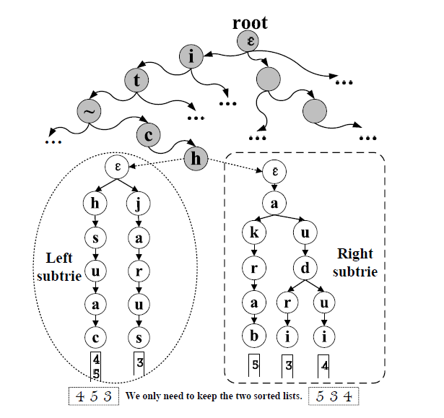
Trie-based Algorithm
How to extend?
Two-level Trie
  Upper
    segments
  Lower
    Left parts
    Right parts
DB Training - Approximate Entity Extraction
Notes:
To avoid the duplicated computations on the shared segment
across different substrings

Slide 64
Observation
Even Partition:
vanateshe
van
ate
she
DB Training - Approximate Entity Extraction

Slide 65
Partition Optimization
Even Partition:
vanateshe
Extend 5 times.
C=5
van
ate
she
an efficient filter for approximate membershep
checking. kaushit chekrabarti, surajit chaudhuri, vankatesh ganti, dong xin. vancouver, canada. sigmod 2008.
DB Training - Approximate Entity Extraction

Slide 66
Observation
Uneven Partition:
vanateshe
vana
tes
he
DB Training - Approximate Entity Extraction

Slide 67
Observation
Uneven Partition:
vanateshe
Extend 2 times.
C=2
vana
tes
he
an efficient filter for approximate membershep
checking. kaushit chekrabarti, surajit chaudhuri, vankatesh ganti, dong xin. vancouver, canada. sigmod 2008.
DB Training - Approximate Entity Extraction

Slide 68

Optimization Objective
Entity: c₁ c₂ c₃ c₄ … … c_{m-2} c_{m-1} c_{m}
Segments:
g₁
g₂
… …
g_{τ}
g_{τ+1}
Appear Time:
Wg₁
Wg₂
Wg_{τ}
Wg_{τ+1}
Document
Optimization Objective: C=M[τ+1][m].
M[i][j]: the minimum partition weight
to partition c₁c₂ … c_{j-1}c_{j} into i segments.
DB Training - Approximate Entity Extraction

Slide 69
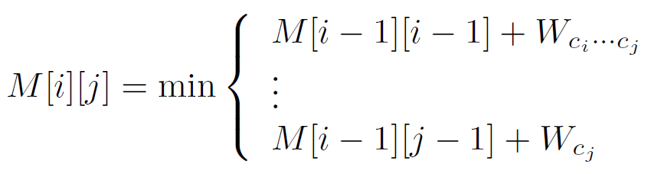
Dynamic Way:
Consider M[i][j]. Split s[1…j] into i segments
If the start position of last partition is j, then:
M[i][j]=M[i-1][j-1]+W_{cj}
Iterative we have
DB Training - Approximate Entity Extraction

Slide 70
Determining Wg
Build A Suffix Trie.
Suffix trie is expensive. Use sampling based methods
The segment g
The number of subtrie leaf nodes
= The occurrence time in document = Wg
DB Training - Approximate Entity Extraction

Slide 71

DB Training - Approximate Entity Extraction

